Slide 1
Business Process Modelling and Enterprise Architecture
BPMN – Introduction, Tasks and Gateways (2/2)

Slide 2
Session Plan
BPMN Basic Elements
BPMN aspects modelling
BPMN Activity
BPMN Basic Task Types
BPMN Gateway

Slide 3
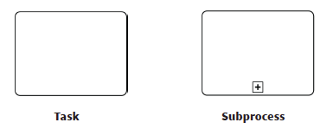
BPMN Activity
An activity represents an unit of work performed.
  A step inside a process
  It is labelled as Verb + Object, adhering to OO principles
    E.g. “acquire payment” not “first take care of payment”
  There are two types of activities

Slide 4





BPMN Basic Task Types
 | None Task: This is the generic representation of a task and the one you will use more than 90% of the time
 | Service Task: represents work that is performed by an external system where there is no human intervention, like a webservice.
 | Send Task: represents sending a message to an external participant. Once sent, the task is completed
 | Receive Task: waits for the arrival of a message from an external participant
 | User Task: represents work that is performed by a human user with the help of the BPM engine or another software application

Slide 5



BPMN Basic Task Types
 | Manual Task: represents work that is not automated and is performed outside the control of the BPM engine
 | Business Rule Task: represents work executed at run-time in a business rule engine, generally, a complex decision..
 | Script Task: represents work that is performed by the BPM engine as an automated function written in a script language like Javascript

Slide 6
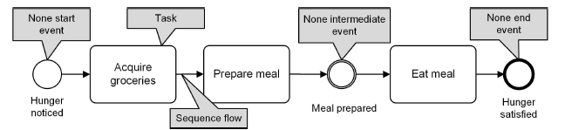
A simple BPMN Process

Slide 7
A simple BPMN Process
Sequence Flow
  The generic Representation of a flow
Conditional Sequence Flow
  Used when specific conditions are met at a decision gate
Default Sequence Flow
  Are used when no other conditions are met
  Similar to default option of Switch/Case statements, used to avoid deadlocks Association is used to link information and artefacts with flow objects
It is used with the data object notations
  Association
  Directional Association
  Bi-directional Association

Slide 8
BPMN Gateway
Modelling notation aimed at:
  Control how sequence flows
  Split a process
  Merge a process
  Fork a process
Can be thought as a question asked at the point of the process flow
  Exclusive OR (XOR)
  AND Parallel forking and joining
  Inclusive OR
  Complex Decision Merges

Slide 9




BPMN Basic Gateways
 | Exclusive OR (XOR): send a token down only one outgoing path (exclusively). Merging : the Gateway will “pass through” any token from any incoming paths
 | Parallel AND: send a token down all outgoing paths (in parallel). Merging : the Gateway will wait for a token from all incoming paths.
 | Inclusive OR: send a token down one to all outgoing paths (inclusively) depending on the evaluation of all Sequence Flow conditions Merging: the Gateway will wait for a token from one to all in- coming paths depending on which paths are expecting a token .

Slide 10


BPMN Basic Gateways
 | Complex: the Gateway will send a token down one to all outgoing paths (inclusively) depending on the evaluation of single Gateway condition. Merging : the Gateway will wait for a token from one to all incoming paths depending on the evaluation of a single Gateway condition
 | Event: the Gateway sends a token down only one outgoing path (exclusively) depending on the occurrence of a specified Event (e.g., the arrival of a message ). Merging : the Gateway will “pass through” any token from any incoming paths.

Slide 11
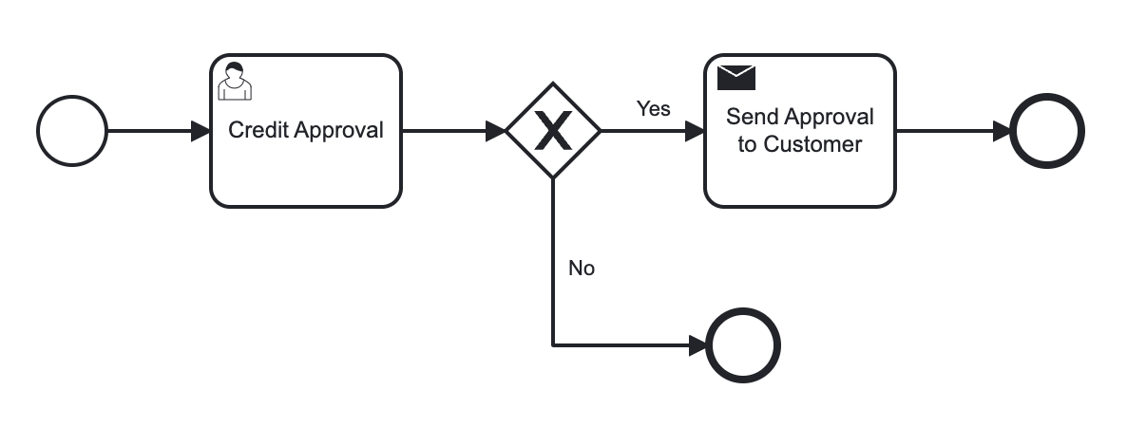
Exclusive Gateway Splitting Behaviour
T
Notes:
Exclusive Gateways will split the flow when they have two or more outgoing paths. The Process (a token ) will continue down only one of them. Thus, when considering tokens , even though multiple outgoing Sequence Flow exist, only one token is passed on through one of those Sequence Flow.

Slide 12
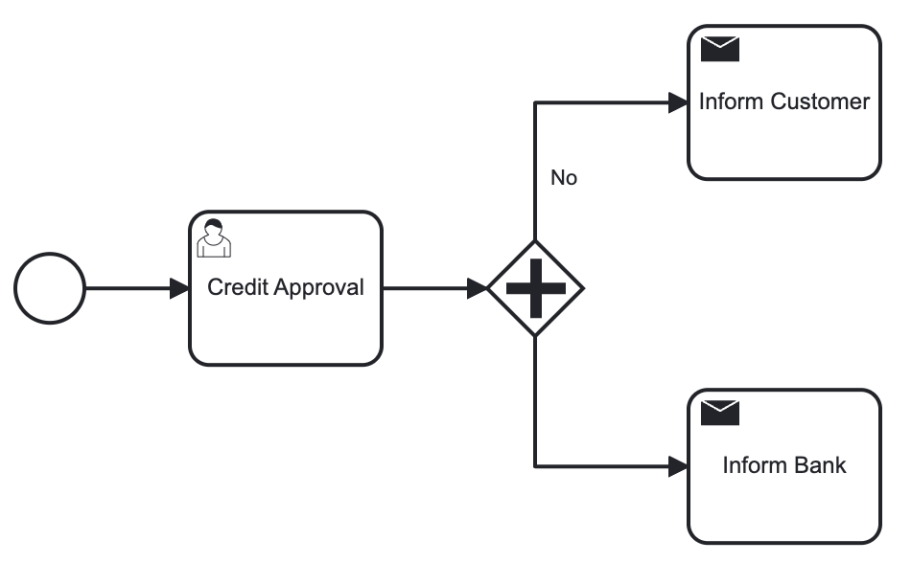
XOR Gateway spit behaviour
T
T

Slide 13
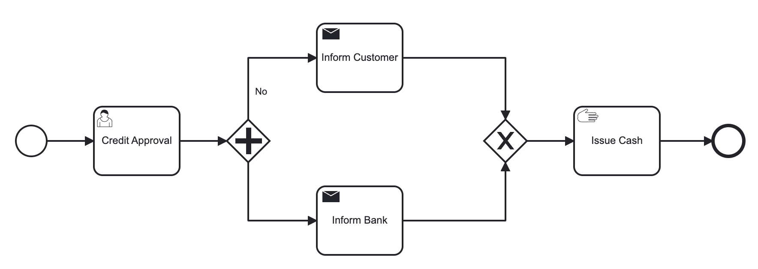
XOR Gateway Merging Behaviour
T
T

Slide 14
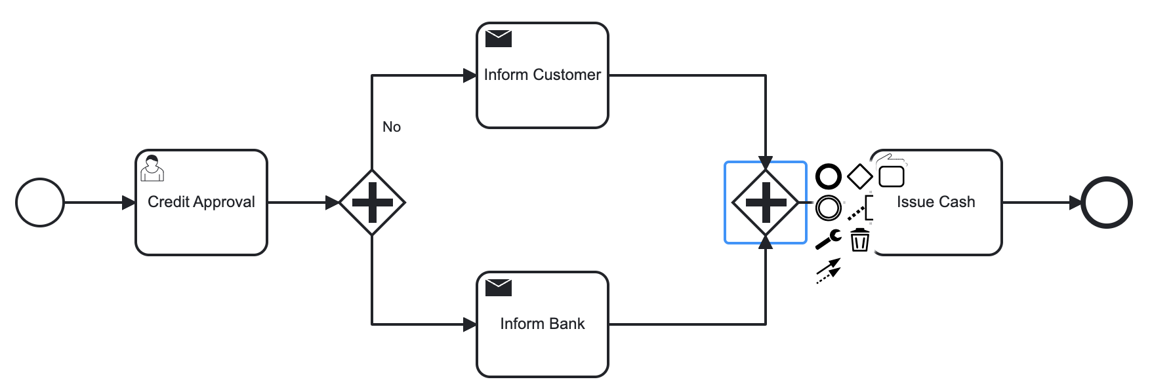
AND Gateway Merging Behaviour
T
T

Slide 15
References and Further Reading
BPMN 2.0 by example
https://www.omg.org/cgi-bin/doc?dtc/10-06-02.pdf
Real-life BPMN
https://www.omg.org/oceb-2/documents/real-life-bpmn-CamundaOCEB-2-DownloadSection.pdf
BPMN Specification
https://www.omg.org/spec/BPMN/2.0/About-BPMN/

Slide 16
Business Process Modelling and Enterprise Architecture
BPMN – Introduction, Tasks and Gateways (2/2)

